Slide 1
Introduction to Light

Slide 2
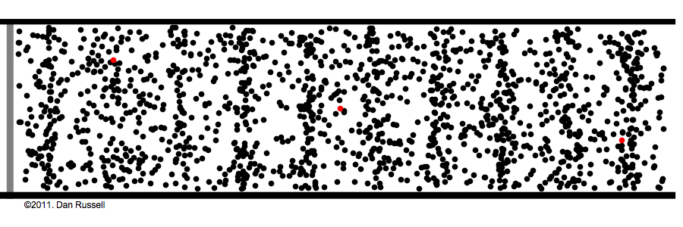

What is Light?
Light can be understood as a wave or a particle. Both approaches are necessary to fully explain the way light behaves. We will begin by considering it as a wave.
As you may remember from last year, waves are travelling disturbances that transport energy from one location to another without transporting matter.
We focussed on mechanical waves: waves that disturb particles in a physical medium (e.g. sound).
Mechanical waves can be longitudinal (disturbances are parallel to wave direction) or transverse (disturbances are perpendicular to wave direction).
They have an amplitude, wavelength, frequency, period, and speed.

Slide 3
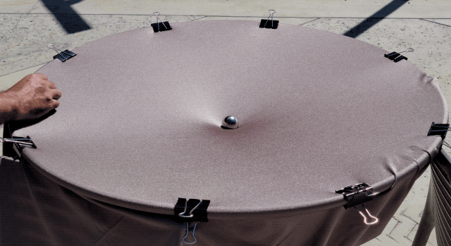
What is Light?
Light is a transverse wave that is not mechanical: it does not require a medium to travel through. So what is being disturbed? And what is it being disturbed by?
Up to this point we have thought of electric and magnetic fields as being ‘produced’ or ‘created’ by charged or magnetic objects. Going forward it will be more helpful to think of these fields as existing everywhere, but simply being ‘zero’ (i.e. objects experience no force) unless a charged or magnetic object comes and changes them.
To use the gravity well illustration: if you take the heavy ball away, the sheet (field) is still there – it’ll just be flat (zero), so it won’t affect the motion of the marble.

Slide 4
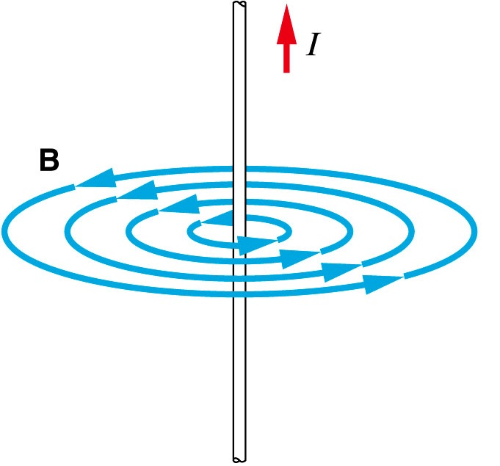
What is Light?
We call light an electromagnetic wave because it is a travelling disturbance of the electric and magnetic fields.
Light can travel without a medium because these fields exist everywhere.
Light is produced by the oscillation of charged particles (usually electrons), which causes ongoing disturbances in the electric field.
We already know that magnetic fields are also produced by the movement of charged particles, so this oscillation will also produce ongoing disturbances in the magnetic field.

Slide 5
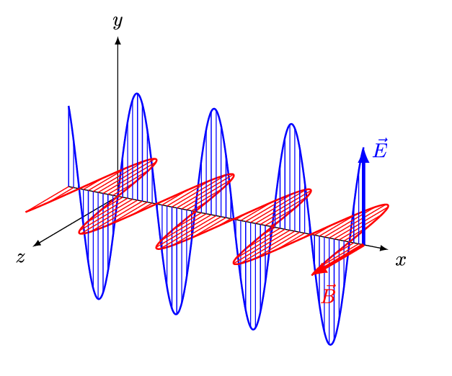
What is Light?
Since they are produced by the same oscillation, these disturbances are in phase with each other.
(They’re also at right angles to each other, but you don’t need to know why.)
These disturbances propagate (travel outwards) from the source at the speed of light, like a really, really, ridiculously fast 3D ripple through the electric and magnetic fields.
The frequency of this wave will match the frequency of the original oscillation.
If the wave passes through other charged particles, it will cause them to oscillate at the same frequency.
This is how radios work! (Not just the one that plays music in your car, but also TV, Wi‑Fi, Bluetooth, 4G/5G, keyless entry, garage doors…)
Notes:
Note that the animation shows the direction and magnitude of the fields at each point along the x line only. Reality is much more cluttered!

Slide 6
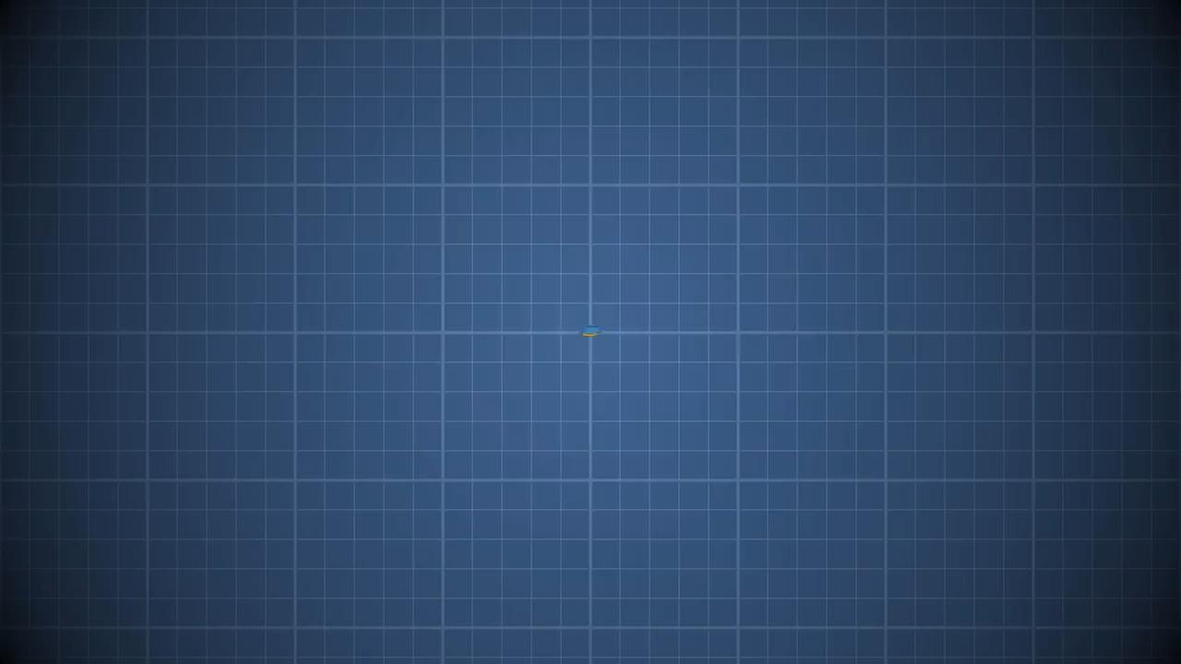
Notes:
Note that the maths in this video is far more advanced than what you need to know.
Another helpful video: https://youtu.be/hk63uUhkZH4
I also really like https://youtu.be/BUYeQa_-ojk but it’s a little simplistic so make sure you understand the others too!

Slide 7
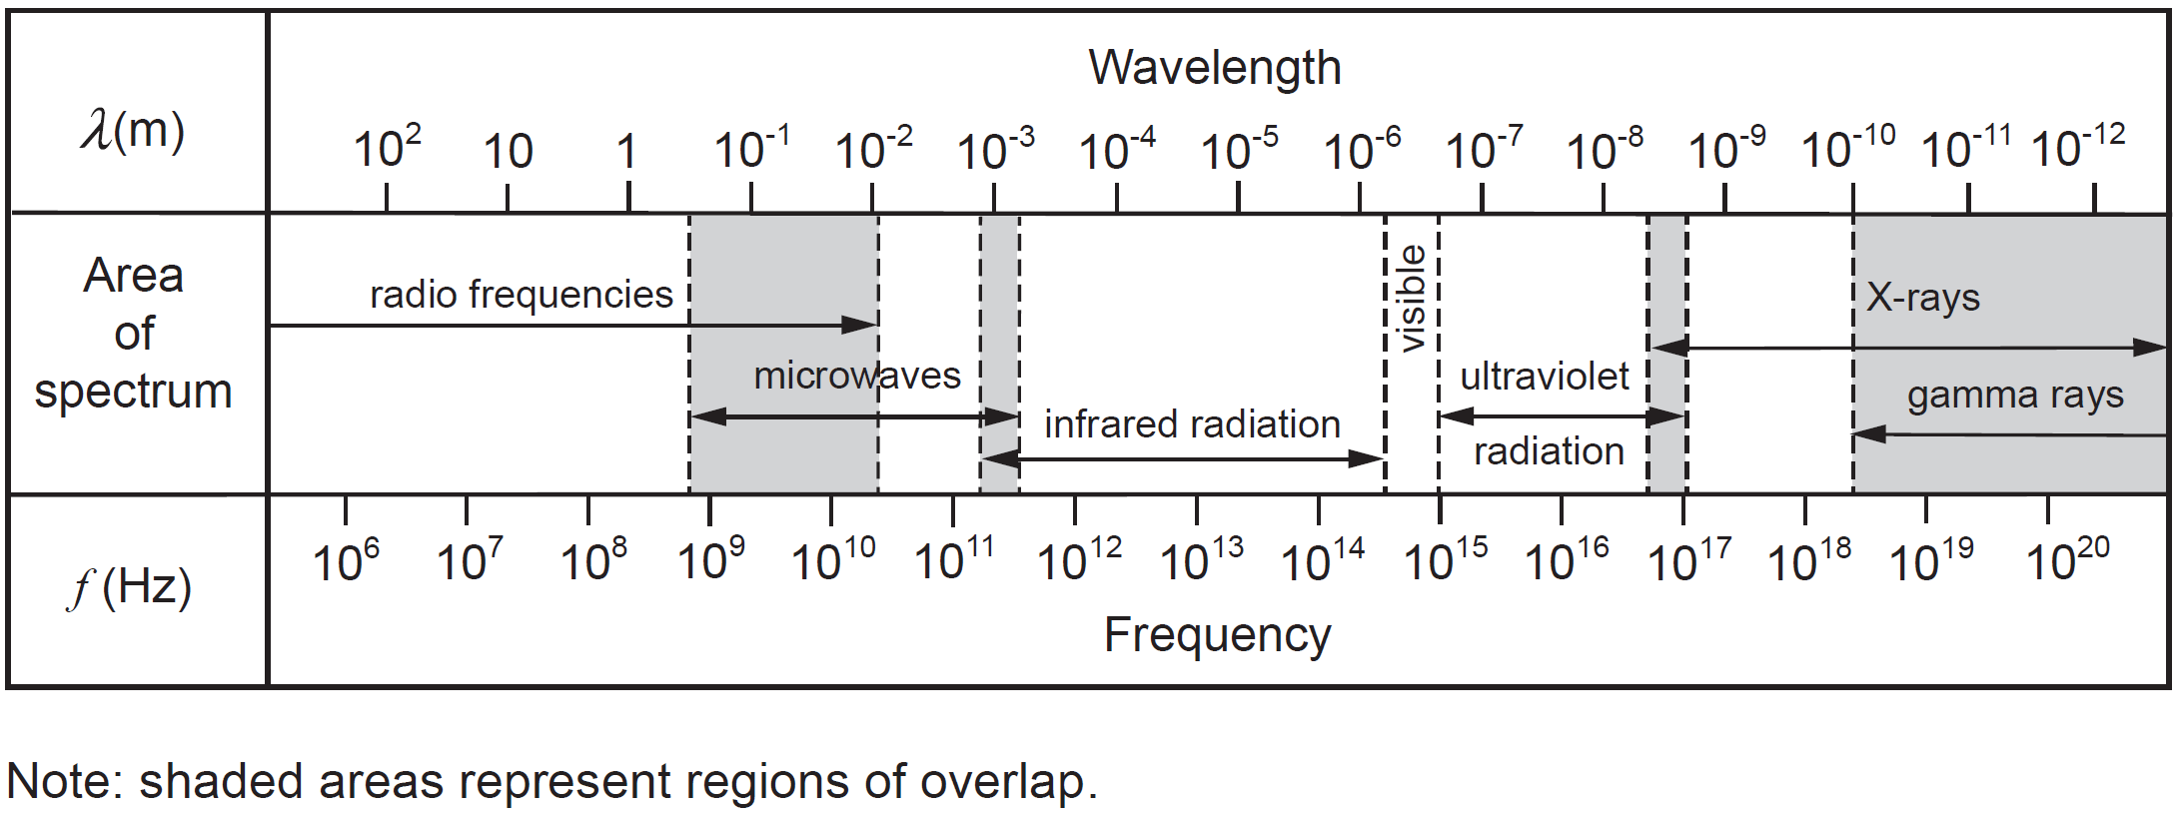
The Electromagnetic Spectrum
We have different names for electromagnetic radiation based on its wavelength/frequency and properties. Your Formulae and Data sheet provides the following information:

Slide 8
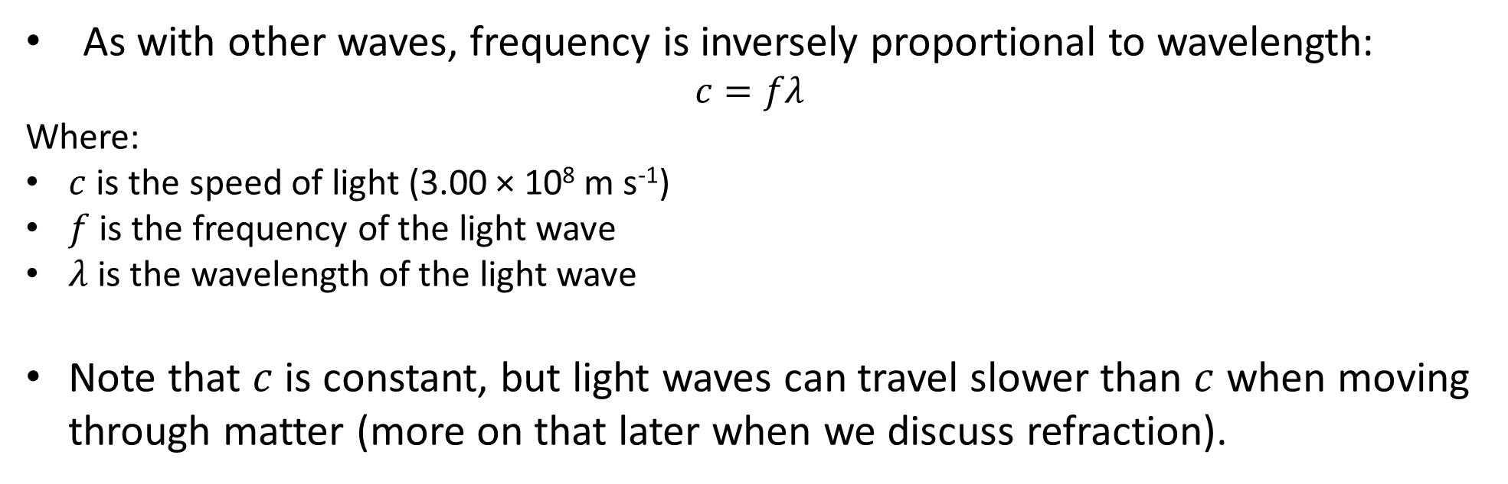
The Electromagnetic Spectrum
As with other waves, frequency is inversely proportional to wavelength:
$$c=fλ$$
Where:
$c$ is the speed of light (3.00 × 10⁸ m s⁻¹)
$f$ is the frequency of the light wave
$λ$ is the wavelength of the light wave
Note that $c$ is constant, but light waves can travel slower than $c$ when moving through matter (more on that later when we discuss refraction).

